Slide 1
Design and Analysis of Algorithms
Algorithms-II : CS345A
Lecture 9
A generic approach to design Greedy Algorithms
Huffman code : A data compression algorithm

Slide 2
Recap the last lecture

Slide 3
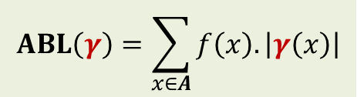
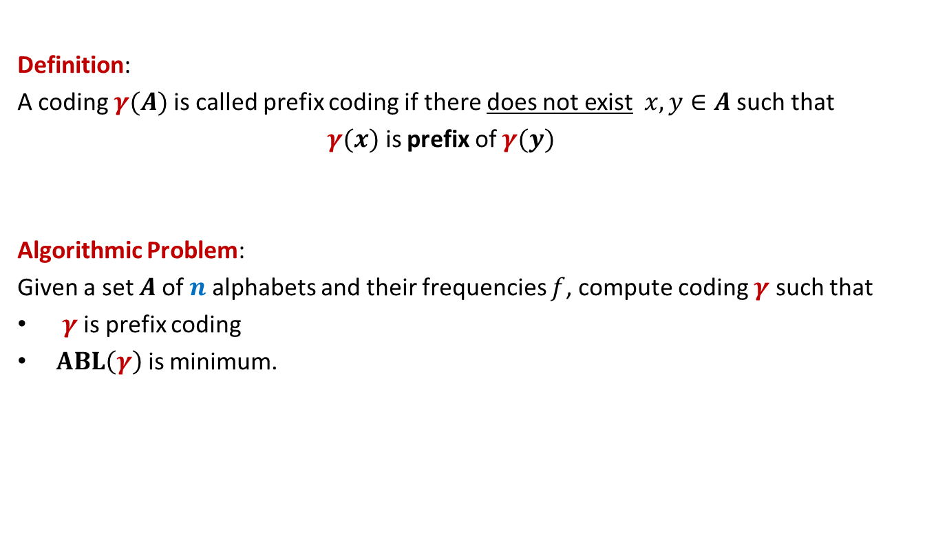
Prefix Coding
Definition:
A coding $γ(A)$is called prefix coding if there does not exist $x,y∈A$ such that
$γ(x)$ is prefix of $γ(y)$
Algorithmic Problem:
Given a set $A$of $n$alphabets and their frequencies $f$, compute coding $γ$ such that
$γ$ is prefix coding
$ABL\left(γ\right)$ is minimum.
$$ABL\left(γ\right)=\sum_{x∈A}{f\left(x\right).\left|γ\left(x\right)\right|}$$

Slide 4

The novel idea of Huffman
?
0
1
0
1
0
1
Binary coding
Labeled
Binary tree

Slide 5
A labeled binary tree
leaf nodes → alphabets
Code of an alphabet =
0
1
0
1
1
0
0
1
0
1
0
1
0
1
Label of path from root

Slide 6
A labeled binary tree
leaf nodes → alphabets
Code of an alphabet =
0
1
01,
001,
0000,
11,
100,
10110,
10111
0
1
1
0
0
1
0
1
0
1
0
1
Label of path from root

Slide 7
Homework from last class
Design an algorithm that given a prefix coding for a set of alphabets, builds the corresponding labeled binary tree.
Ponder over the properties of the labeled binary tree of the optimal prefix coding.
Just ask yourself : How will that tree look like ?

Slide 8


Prefix Coding
Question:
How to build the labeled tree for a prefix code ?
Alphabets | Frequency $f$ | Encoding $$γ$$
$$a$$ | 0.45
$$b$$ | 0.18
$$c$$ | 0.15
$$d$$ | 0.12
$$e$$ | 0.10
0
{0, 100, 101, 110, 111}
0
1
100
110
{00,01,10,11}
$$a$$
101
111

Slide 9
Prefix Coding
Question:
How to build the labeled tree for a prefix code ?
Alphabets | Frequency $f$ | Encoding $$γ$$
$$a$$ | 0.45
$$b$$ | 0.18
$$c$$ | 0.15
$$d$$ | 0.12
$$e$$ | 0.10
0
0
1
100
110
0
1
$$a$$
101
{0,1}
{0,1}
111

Slide 10




Prefix Coding
Question:
How to build the labeled tree for a prefix code ?
Alphabets | Frequency $f$ | Encoding $$γ$$
$$a$$ | 0.45
$$b$$ | 0.18
$$c$$ | 0.15
$$d$$ | 0.12
$$e$$ | 0.10
0
0
1
100
110
0
1
$$a$$
101
0
1
0
1
111
$$b$$
$$d$$
$$c$$
$$e$$

Slide 11
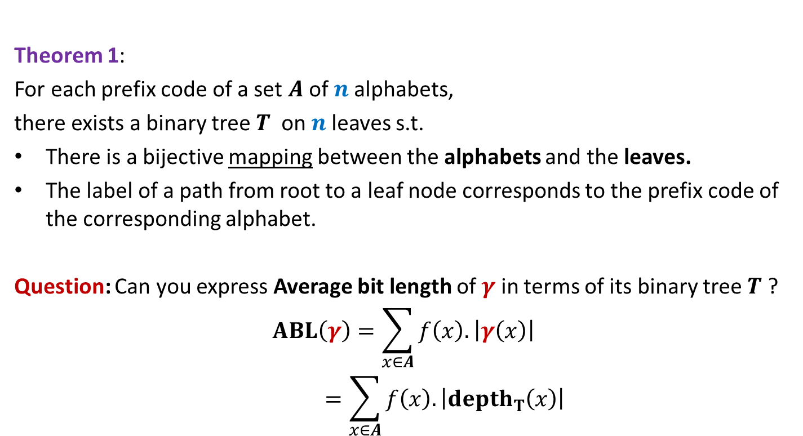
Theorem 1:
For each prefix code of a set $A$of $n$alphabets,
there exists a binary tree$T$ on $n$leaves s.t.
There is a bijective mapping between the alphabets and the leaves.
The label of a path from root to a leaf node corresponds to the prefix code of the corresponding alphabet.
Question: Can you express Average bit length of $γ$ in terms of its binary tree $T$ ?
$$ABL\left(γ\right)=\sum_{x∈A}{f\left(x\right).\left|γ\left(x\right)\right|}$$
$$=\sum_{x∈A}{f\left(x\right).\left|depth_{T}\left(x\right)\right|}$$

Slide 12
Finding the labeled binary tree for
the optimal prefix codes

Slide 13
Is the following prefix coding optimal ?
full binary tree
0
1
0
1
1
0
0
1
0
1
0
1
0
1

Slide 14


Observations on the binary tree of the optimal prefix code
Lemma:
The binary tree corresponding to optimal prefix coding must be a full binary tree:
Every internal node has degree exactly 2.
Question: What next ?
We need to see the influence of frequencies on the optimal binary tree.
Non-decreasing order of frequency
$${f(a}_{i})≤{f(a}_{i+1})$$
$a_{1}$ , $a_{2}$ , … , $a_{n}$

Slide 15
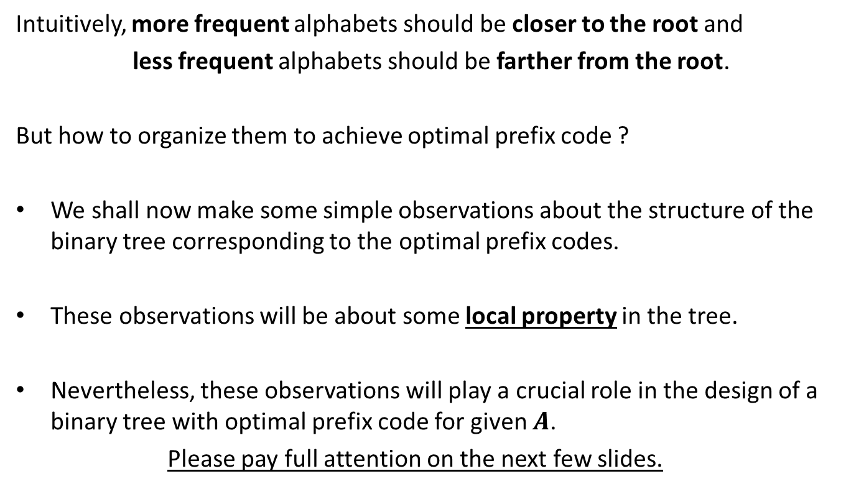
Observations on the binary tree of the optimal prefix code
Intuitively, more frequent alphabets should be closer to the root and
less frequent alphabets should be farther from the root.
But how to organize them to achieve optimal prefix code ?
We shall now make some simple observations about the structure of the binary tree corresponding to the optimal prefix codes.
These observations will be about some local property in the tree.
Nevertheless, these observations will play a crucial role in the design of a binary tree with optimal prefix code for given $A$.
Please pay full attention on the next few slides.

Slide 16

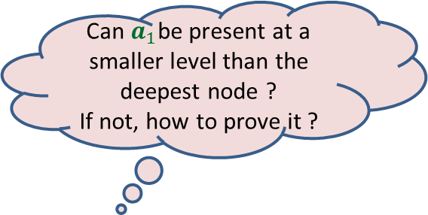

More Observations
Can $a_{1}$be present at a smaller level than the deepest node ?
If not, how to prove it ?
0
1
0
1
0
1
. . .
0
1
0
$$a_{1}$$
Deepest level
$$a_{i}$$

Slide 17


More Observations
0
1
1
Swapping $a_{1}$ with $a_{i}$ can not increase ABL.
0
1
0
. . .
0
1
0
$$a_{1}$$
Deepest level
$$a_{i}$$

Slide 18

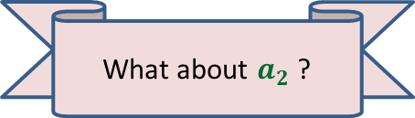

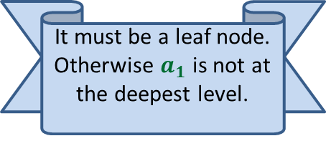


More Observations
0
1
Since the tree is full binary, $a_{1}$ must have a sibling. What can we say about it ?
1
Swapping $a_{2}$ with $a_{i}$ can not increase ABL.
0
1
0
It must be a leaf node. Otherwise $a_{1}$ is not at the deepest level.
. . .
What about $a_{2}$ ?
0
1
$$a_{2}$$
0
1
Deepest level
$$a_{1}$$
$$a_{i}$$

Slide 19
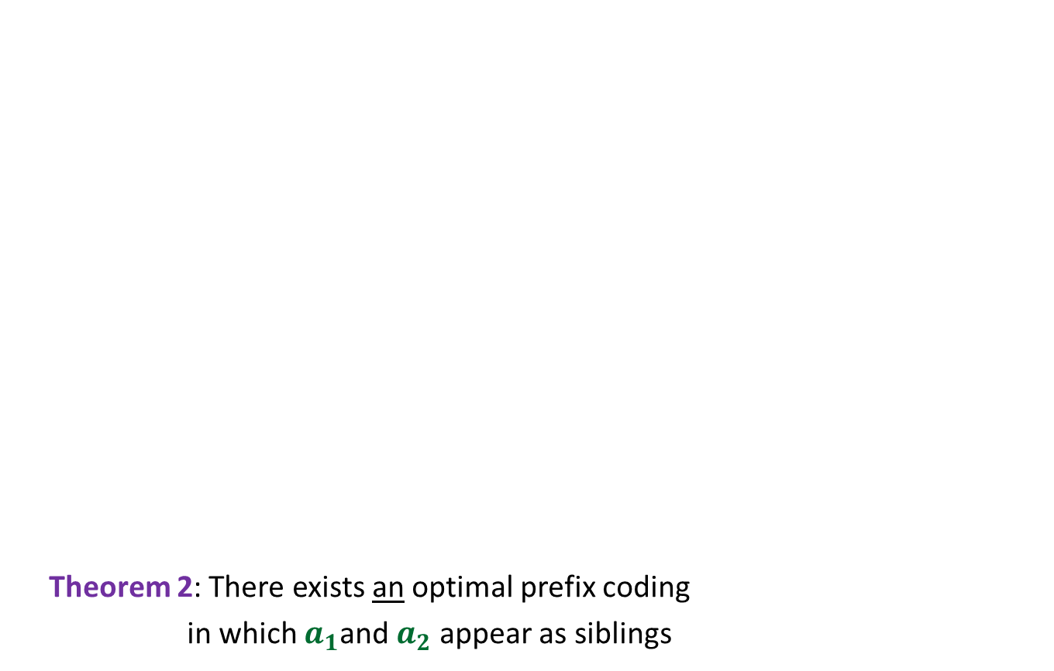

More Observations
0
1
Theorem 2: There exists an optimal prefix coding
in which $a_{1}$and $a_{2}$ appear as siblings
0
1
0
1
. . .
1
0
1
Deepest level
$$a_{1}$$
$$a_{2}$$

Slide 20
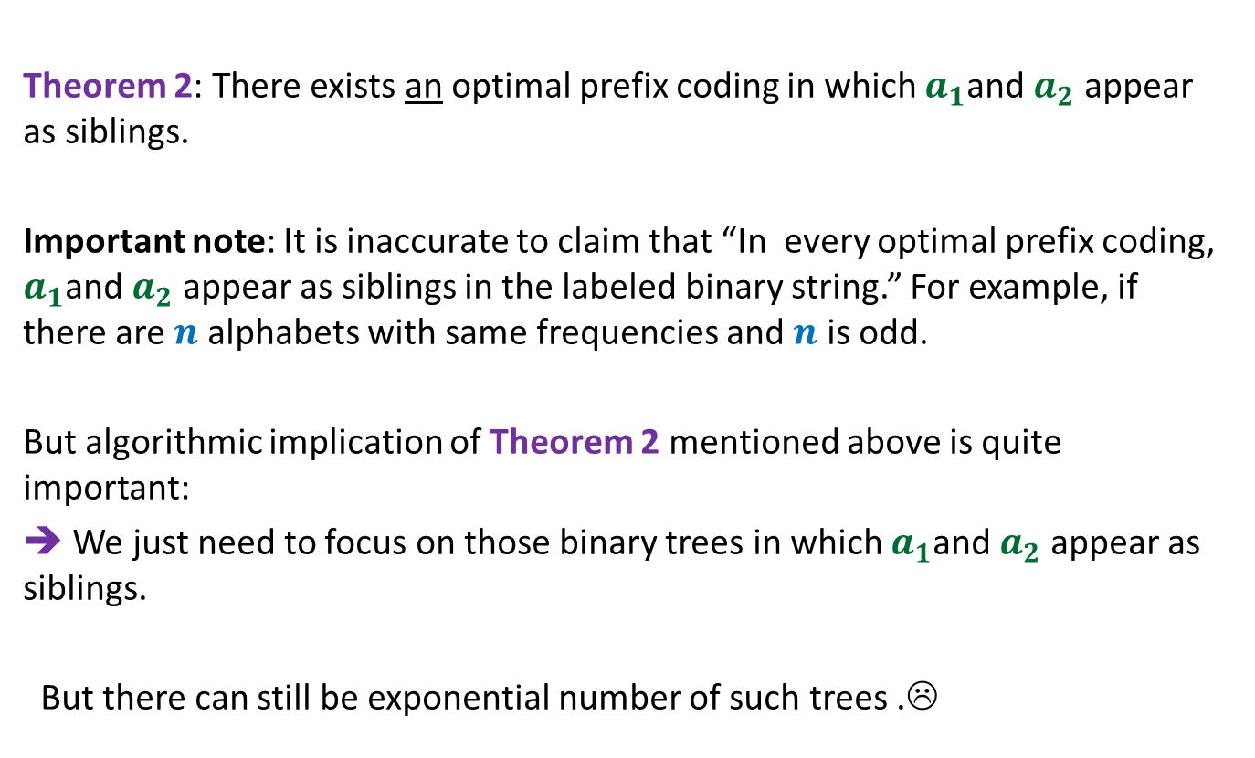
The important observation
Theorem 2: There exists an optimal prefix coding in which $a_{1}$and $a_{2}$ appear as siblings.
Important note: It is inaccurate to claim that “In every optimal prefix coding, $a_{1}$and $a_{2}$ appear as siblings in the labeled binary string.” For example, if there are $n$ alphabets with same frequencies and $n$ is odd.
But algorithmic implication of Theorem 2 mentioned above is quite important:
➔ We just need to focus on those binary trees in which $a_{1}$and $a_{2}$ appear as siblings.
But there can still be exponential number of such trees .☹

Slide 21
Designing a Greedy Algorithm
A generic strategy

Slide 22
Example Minimum spanning tree

Slide 23
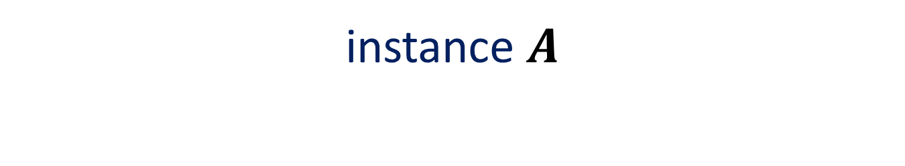
instance $A$
170
54
33
63
35
50
70
31
41
81
64
78
53
42
52
80
49
54
42
60
44
43
50
30
49
57
29
102

Slide 24
instance $A$
Lemma 1 : There is a MST with edge (u,v)
170
54
33
63
35
50
70
31
41
81
64
78
53
42
52
80
49
54
42
60
44
43
50
30
49
57
u
29
102
v

Slide 25
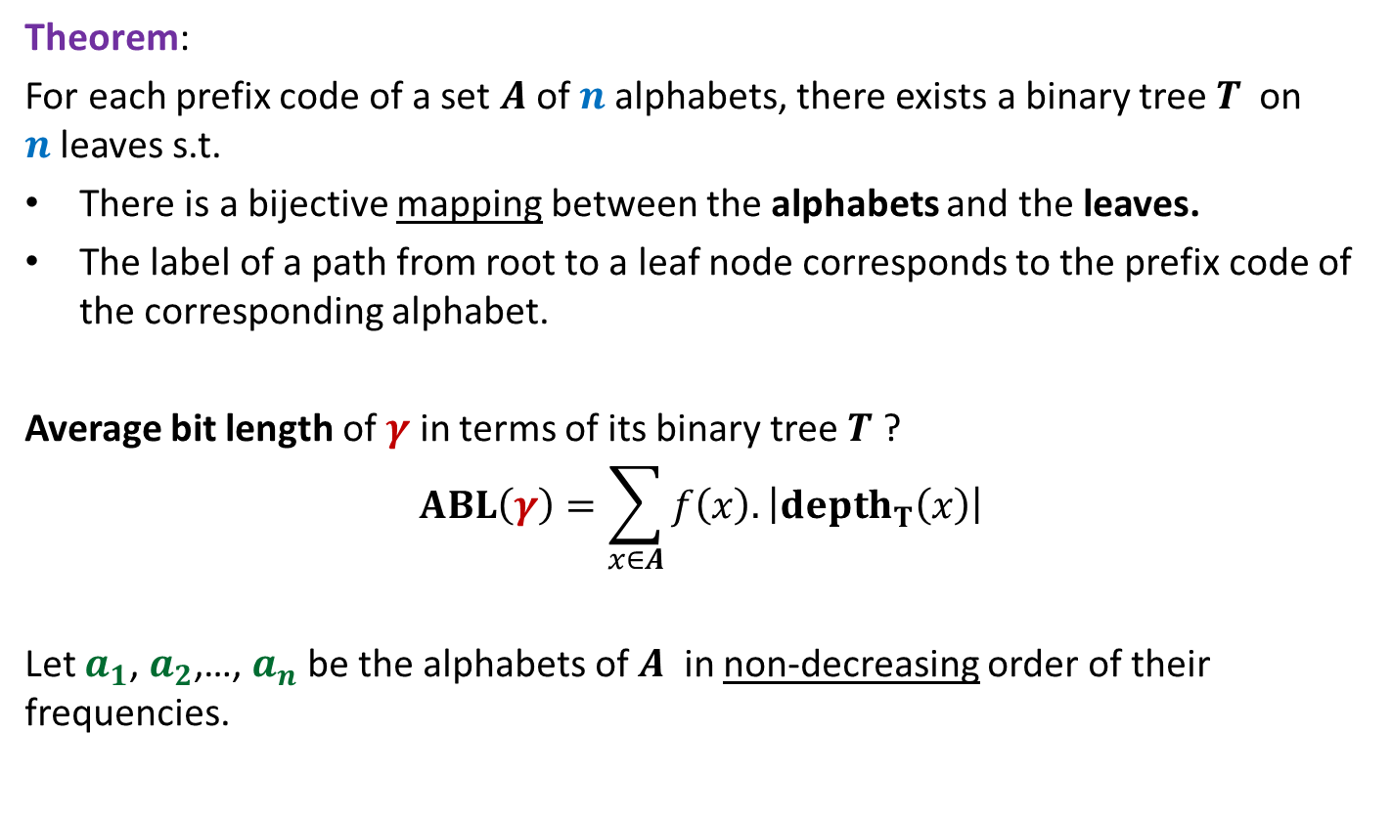
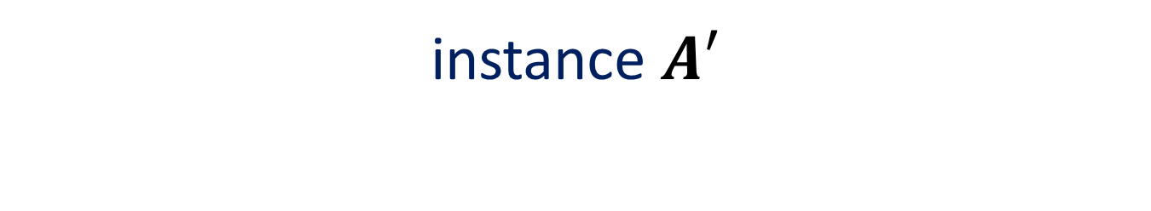
instance $A′$
170
54
33
63
35
50
70
31
41
81
64
78
53
42
52
80
49
54
42
44
60
43
50
30
49
57
w
102
This is graph $G′$

Slide 26
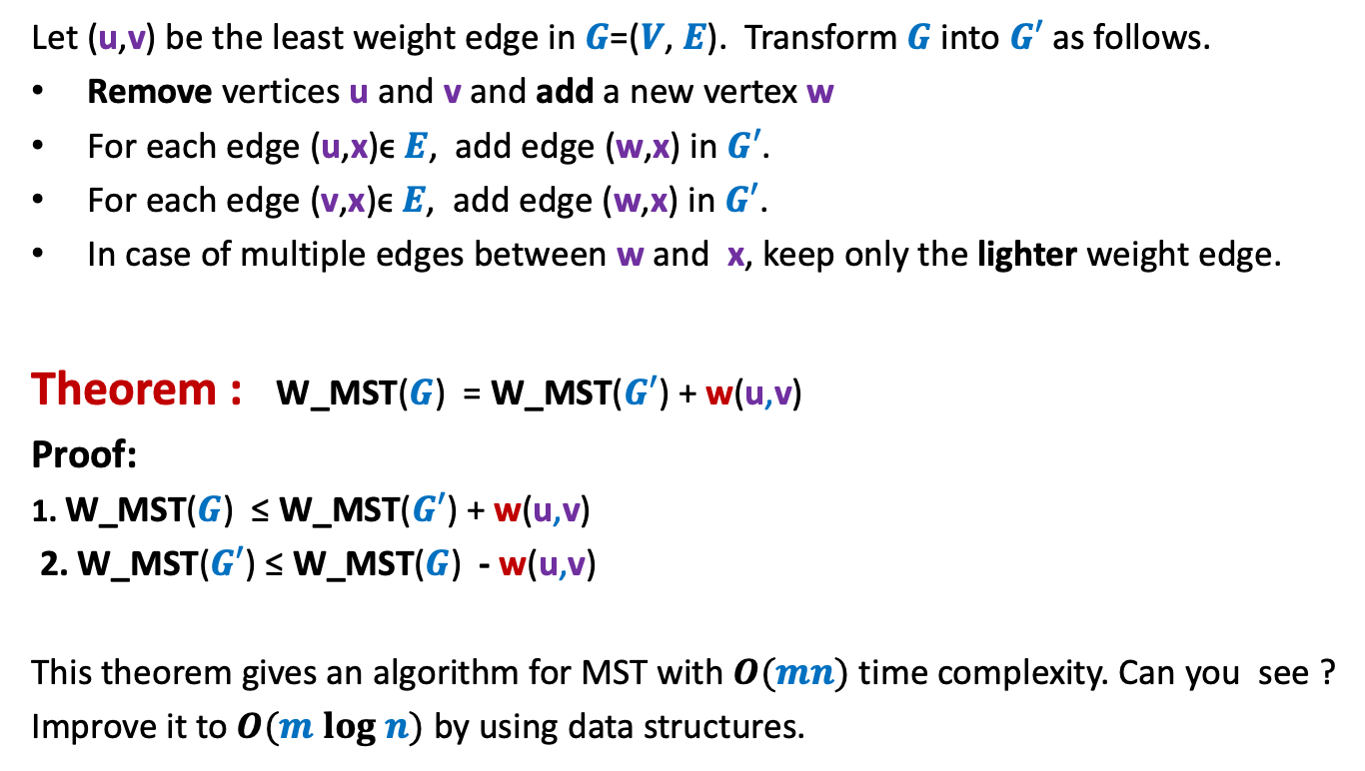
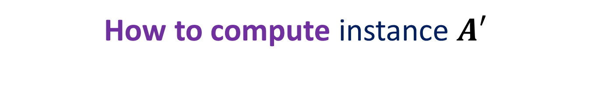
How to compute instance $A′$
Let (u,v) be the least weight edge in $G$=($V$, $E$). Transform $G$ into $G′$ as follows.
Remove vertices u and v and add a new vertex w
For each edge (u,x)ϵ $E$, add edge (w,x) in $G′$.
For each edge (v,x)ϵ $E$, add edge (w,x) in $G′$.
In case of multiple edges between w and x, keep only the lighter weight edge.
Theorem : W_MST($G$) = W_MST($G′$) + w(u,v)
Proof:
1. W_MST($G$) ≤ W_MST($G′$) + w(u,v)
2. W_MST($G′$) ≤ W_MST($G$) - w(u,v)
This theorem gives an algorithm for MST with $O(mn)$ time complexity. Can you see ?
Improve it to $O(m log n)$ by using data structures.
From construction
Use Lemma 1

Slide 27
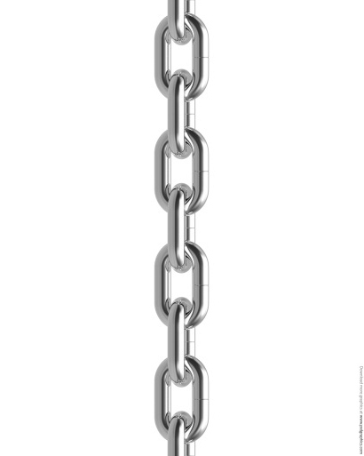

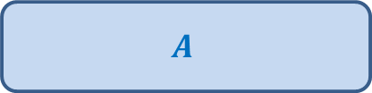


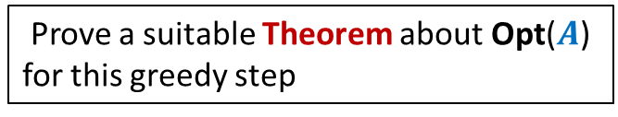
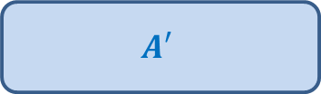

A generic way to design and analyse a greedy algorithm
P: a given optimization problem
1. Try to establish a relation between OPT($A$) and OPT($A′$);
2. Try to prove the relation formally by
deriving a solution of $A$ from OPT($A′$)
deriving a solution of $A′$ from OPT($A$)
If you succeed,
you have an algorithm
Opt($A$)
$$A$$
instance of size $n$of problem P
Greedy
step
Prove a suitable Theorem about Opt($A$) for this greedy step
Opt($A′$)
$$A′$$
instance of size $<n$of problem P
from construction
use Theorem

Slide 28

The binary tree of the optimal prefix code
From this picture, can you design the greedy step that you will perform ?
0
1
0
1
0
1
. . .
1
0
1
Deepest level
$$a_{1}$$
$$a_{2}$$

Slide 29
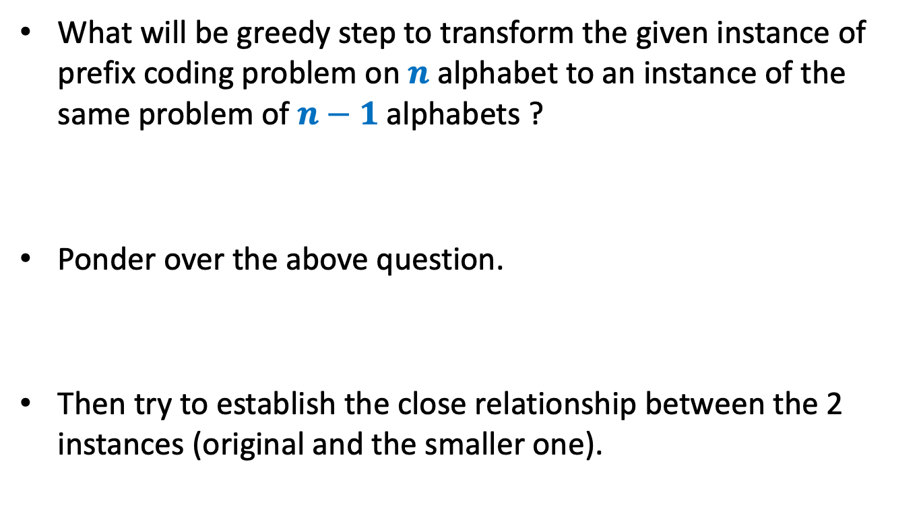
Homework
What will be greedy step to transform the given instance of prefix coding problem on $n$ alphabet to an instance of the same problem of $n−1$alphabets ?
Ponder over the above question.
Then try to establish the close relationship between the 2 instances (original and the smaller one).

